Slide 1
I
Health Supplement Sales Analysis across Three Key Market: Canada, UK, & USA
GILANG PRAMATA WARDHANA
RMT-043
8 July 2025

Slide 2

II
Outline
Background
Visual
Conclusion

Slide 3
Background
III
Background:
Awareness of health is increasing among the public.
Routine consumption of supplements such as protein, vitamins, omega, and amino acids is growing.
Sales of health supplements are also rising.
Sales analysis is needed to understand business growth and distribution of supplements.
The analysis aims to evaluate business growth and identify segments to develop or review in terms of distribution and promotion.
Objective:
The author works as a Data Analyst at a pharmaceutical company.
This report presents weekly supplement sales data by product category, branch location, and discount analysis.
The evaluation focuses on sales by branch, sales platforms, and product segments to understand sales outcomes.
The analysis also aims to detect product shortages caused worse distribution.
Required Division/Team:
The division involved is the Marketing and Sales Division.

Slide 4
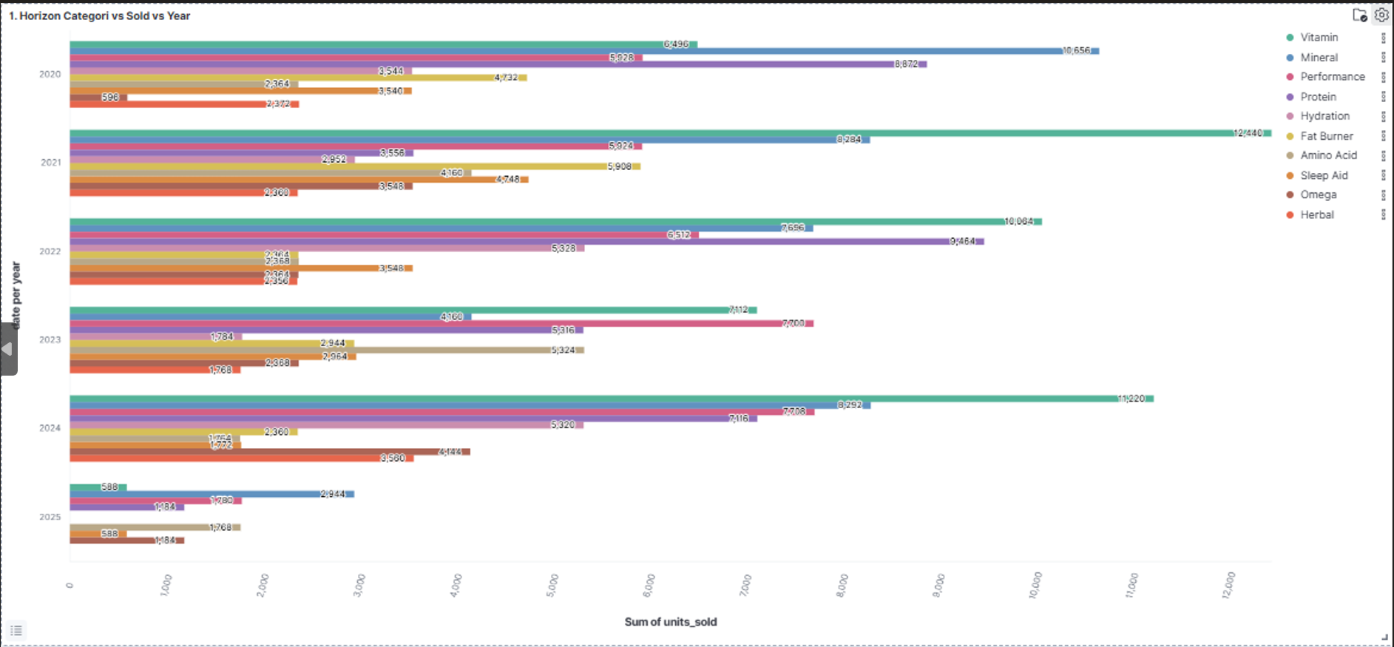

PLOT 1: CATEGORY VS SOLD VS YEAR
IV
Data available from 2020 to 2025 shows sales trends across item segments.
Sales Trends:
Some item segments sow a sales increase in 2021.
Sales declined until 2023.
Sales increased again in 2024 due to several public health-related events.
Impact of COVID-19:
In 2021, the COVID-19 pandemic caused a worldwide surge in demand and sales for several item segments, especially vitamins that support the immune system.
The only segment that experienced a decline during 2021 was the mineral segment.
From 2022 to 2023, after COVID-19 cases were declared over, demand and sales decreased overall.
fat burner and amino acid segments sales growth during 2022-2023 because many people were less active or exercised less during the pandemic period.

Slide 5
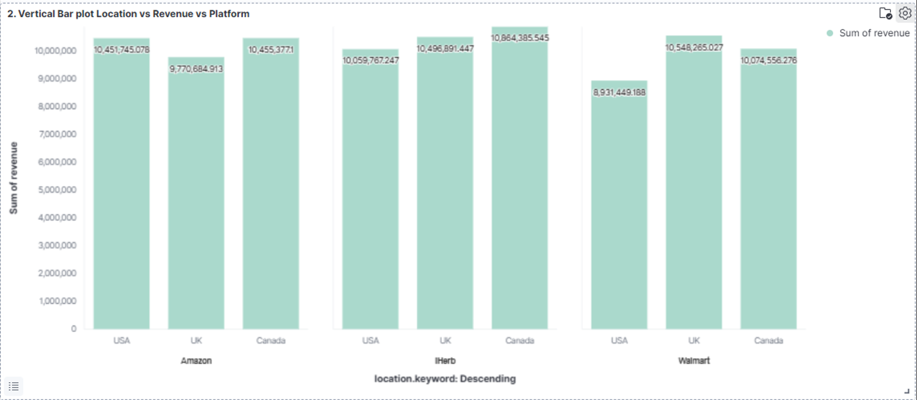
PLOT 2: VERTICAL BAR PLOT LOCATION VS REVENUE VS PLATFORM
Data Context:
The data covers sales across three branches located in Canada, the UK, and the USA.
Sales are tracked on three platforms: Amazon, iHerb, and Walmart.
Sales Platform Performance:
The vertical bar plot indicates that the best sales occur on the iHerb platform.
Walmart shows the lowest sales among the three platforms.
V
RT
Reason for iHerb's Performance:
According to a 2025 e-commerce survey, iHerb has the largest user base and offers the best user experience regarding app service and customer trust.
Advantages such as lower shipping costs and guaranteed distribution motivate users to prefer iHerb over Amazon and Walmart.
You can find more details about this survey here: 2025 e-commerce trends and top online retailers.

Slide 6
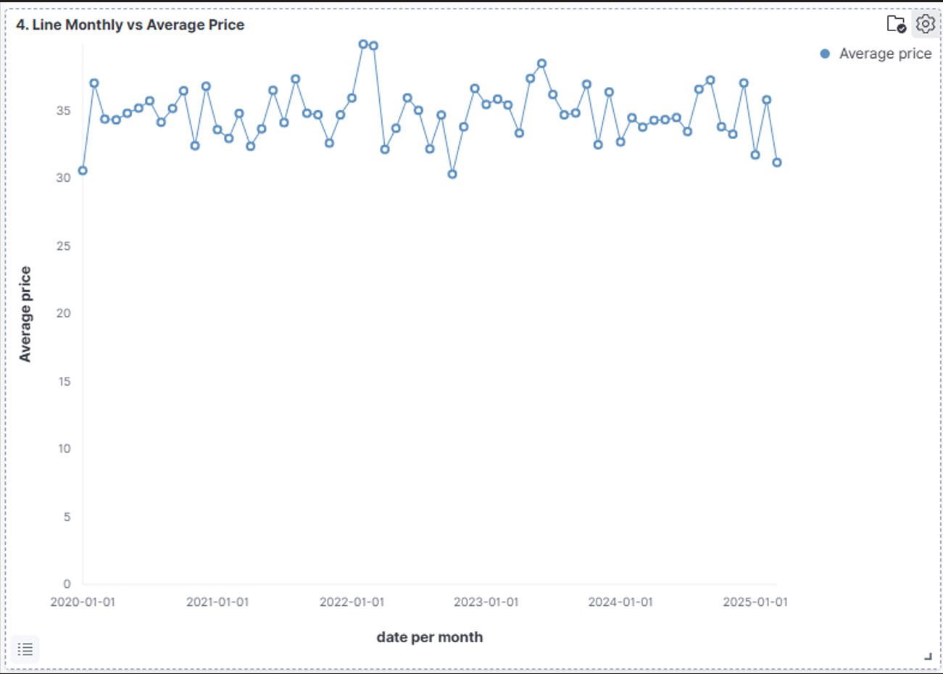
PLOT 3: Line Monthly Vs Average Price
VI
From the average sales price per month from 2020 to January 2025, six phases can be analyzed:
Pre-pandemic period in 2020: price trend was relatively stable with sales fluctuations tending to be normal.
Early pandemic in 2021: drastic drop of about 13% compared to pre-pandemic average prices.
Q3 2021: sales rose due to increased demand for health supplements.
Early 2022 pandemic peak: sales of some items rose significantly due to global supply disruption of supplements amidst high demand and worry customers ran out of goods, leading to many stocking health supplements; however, sales dropped at the end of Q3 2022 because stocks were depleted by customers in Q1 2022.
In 2023: sales normalized and tended to stabilize as Covid ended.
In 2024: sales dropped due to US presidential selection and its effect on global economy affecting e-commerce platforms, stabilizing again at the end of 2024 through 2025.

Slide 7
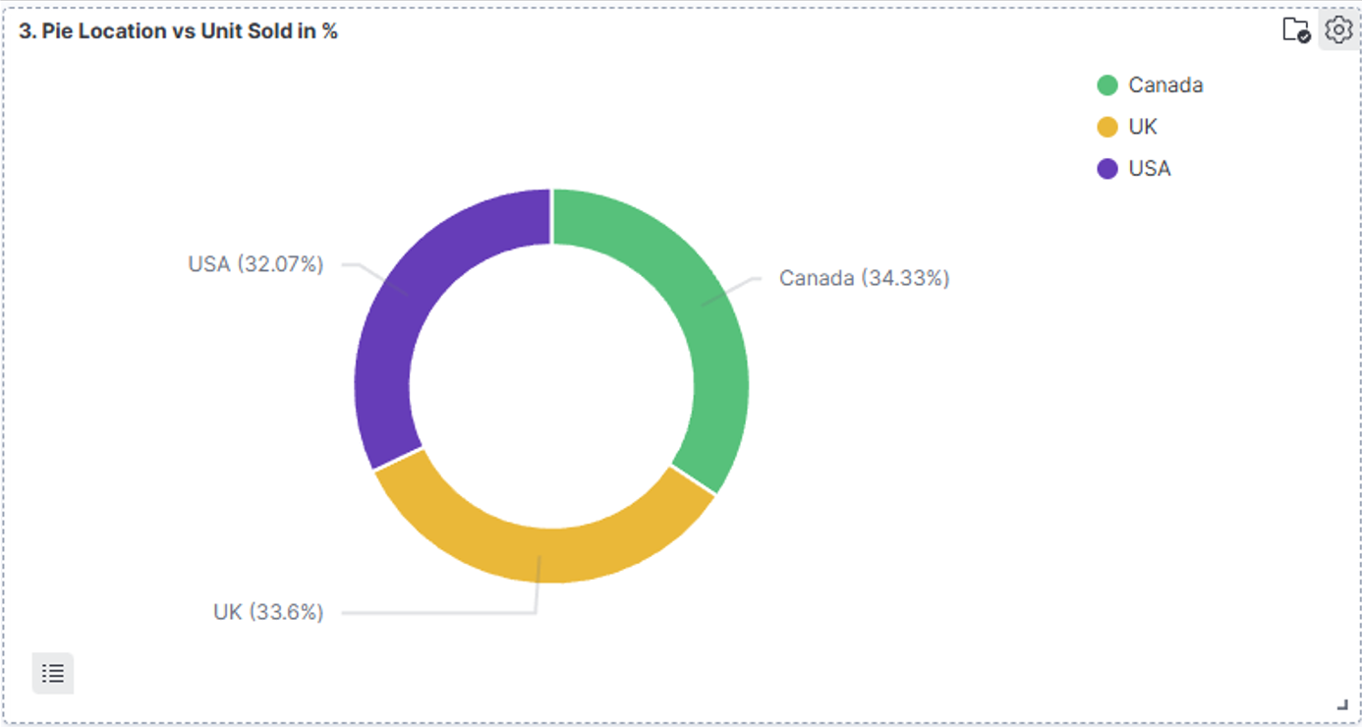
PLOT 4: LOCATION VS UNIT SOLD IN PERCENT
VII
Sales Distribution by Branch:
Sales across the three branches in Canada, USA, and the UK are nearly even.
Canada has the highest sales than USA, and then the UK.
Economic Context:
The USA has a higher per capita income than Canada and the UK, which would typically lead to higher consumption in the USA compared to Canada.
2024 Sales Impact in the USA:
In 2024, the US presidential selection and related seasonal political issues caused a decrease in e-commerce purchases.
Political uncertainties and trade plans proposed by candidates influenced consumer behavior.

Slide 8
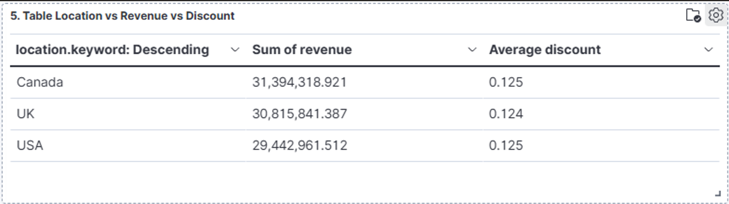
PLOT 5: TABLE LOCATION VS REVENUE VS AVERAGE DISCOUNT
VIII
The table shows total revenue and average discount given in three country branches:
Canada: Highest revenue ($31,394,318.92) with an average discount of 12.5%.
UK: Second highest revenue ($30,815,841.39) with an average discount of 12.4%.
USA: Lowest revenue ($29,442,961.51) with an average discount of 12.5%.
It can be analyzed that the discounts offered are relatively stable across the three countries. Revenue is more influenced by sales volume and product prices than by discounts.

Slide 9
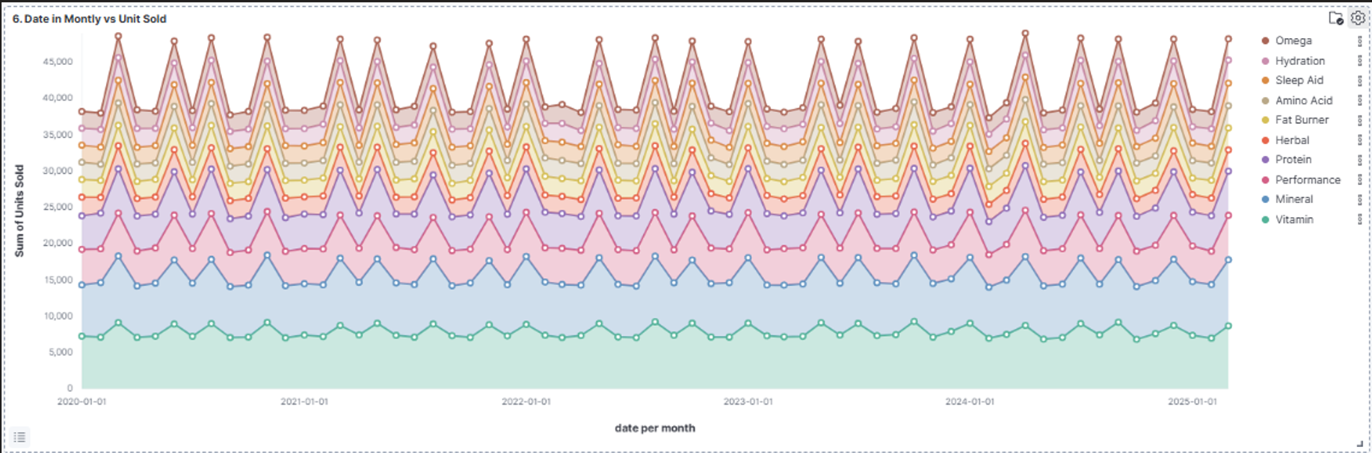
PLOT 6: DATE IN MONTHLY VS UNIT SOLD
IX
The data shows the number of items sold from 10 health segments from January 2020 to January 2025 with monthly sales calculations. There are 3 phases of analysis:
Pre-Pandemic Period (2020): Sales trends were generally stable across items, with top products like Vitamin, Protein, and Mineral dominating. Sleep Aid and Fat Burner showed lower volume.
COVID-19 Pandemic Impact (2021-2022): Significant declines for Performance (-15-20%) and Protein (-10%). Dramatic increases in vitamin (+30-40% due to immune health needs), Sleep Aid (+25% due to sleep disturbances during lockdown), and Omega (+20%, heart health focus). From Q3 2021 to 2022, recovery in Performance sales and Vitamin demand stabilization.
After Pandemic (2023-2025): Normalization process where vitamin and protein remain dominant, but with lower sales compared to previous years. Sleep Aid maintains increased sales post-pandemic.

Slide 10
CONCLUSION
X
1. COVID-19 Impact Creates New Trends
Product segments related to immunity (Vitamin, Omega) and Sleep Aid experienced sales surges.
Product segments (Fat Burner) stagnated or declined due to changes in user consumption patterns.
2. Revenue vs. Discount
Canada and UK lead in revenue despite similar discounts across all countries.
USA needs new strategies to increase sales due to large market potential but lower revenue.
WHAT’S NEXT
Detail evaluation of product growth and decline segments should be the marketing focus, possibly by adding or creating discounts or combining items such as Protein + Hydration, Omega + Herbal to boost sales.

Slide 11
XII
RT
THANK
YOU…..

